Slide 1
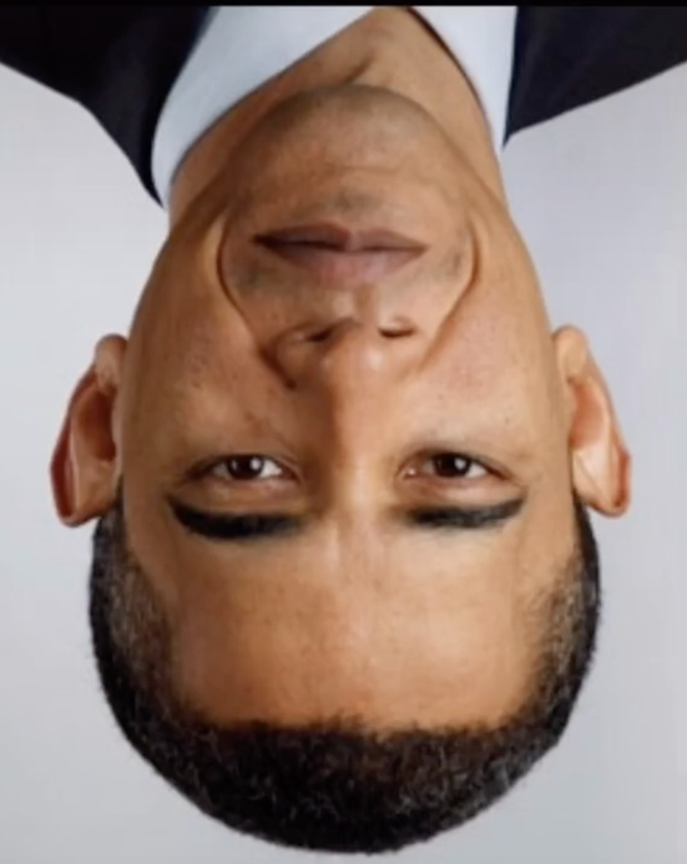
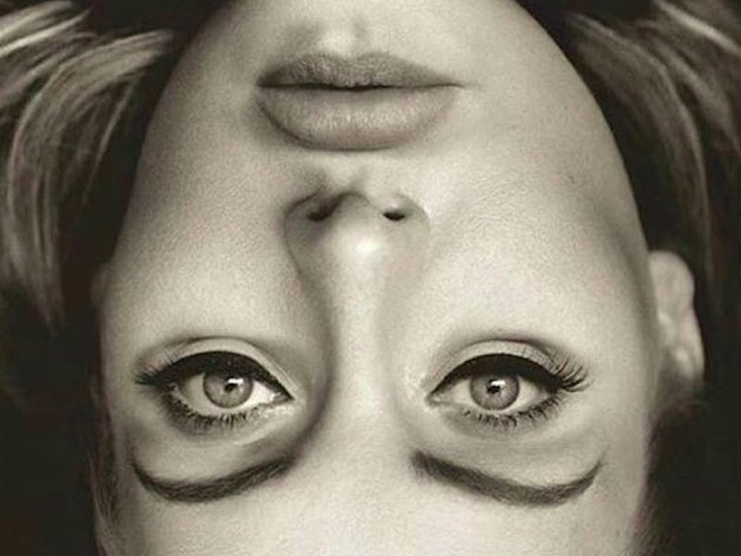
Should facial recognition systems be regulated?

Slide 2
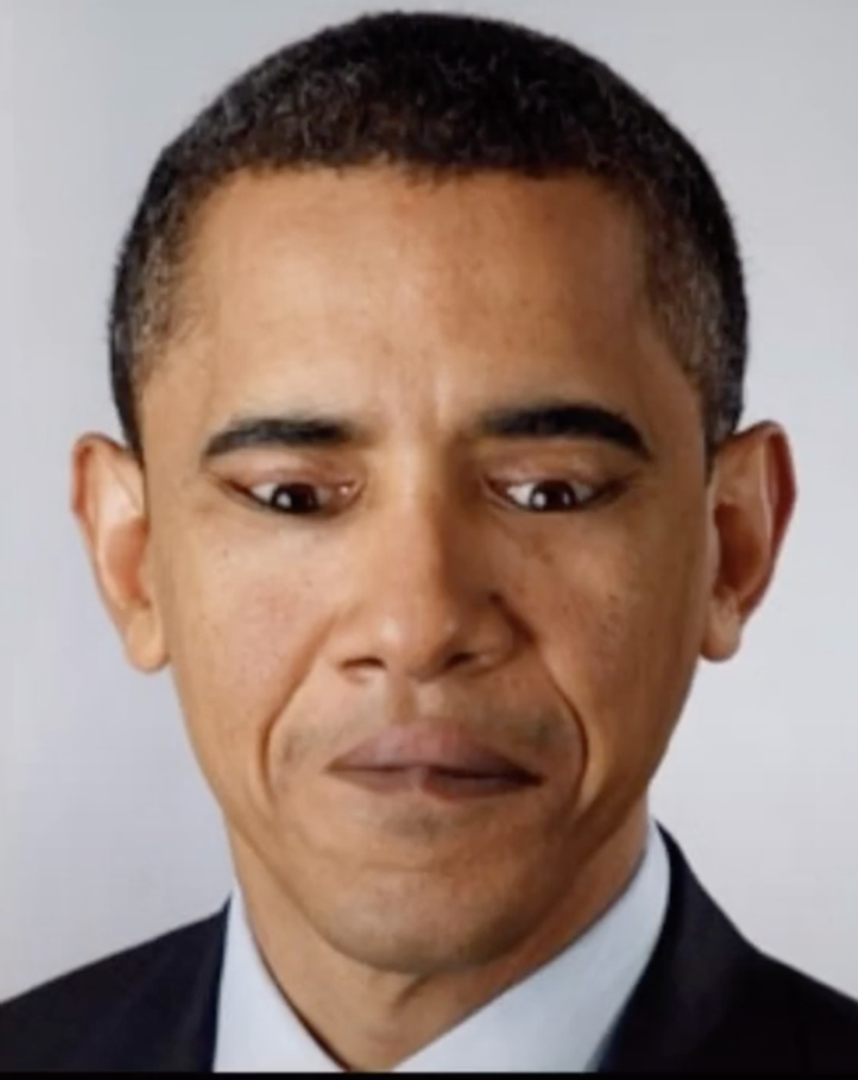
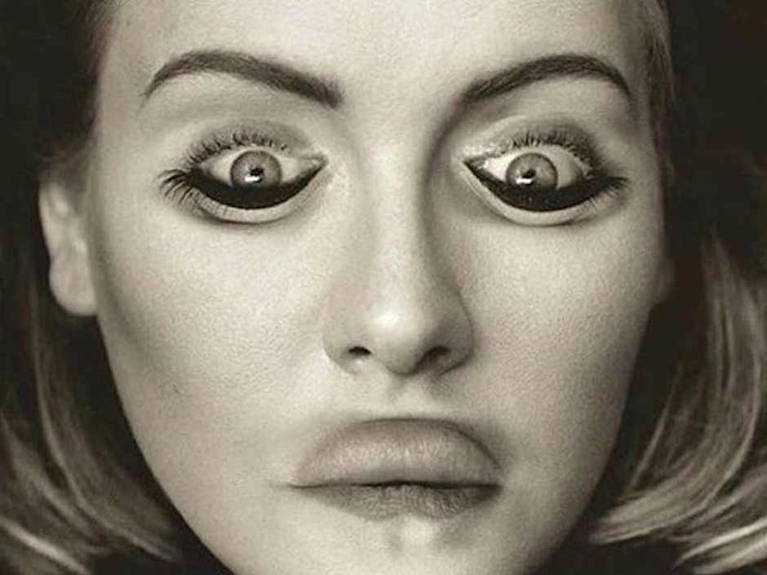

Slide 3
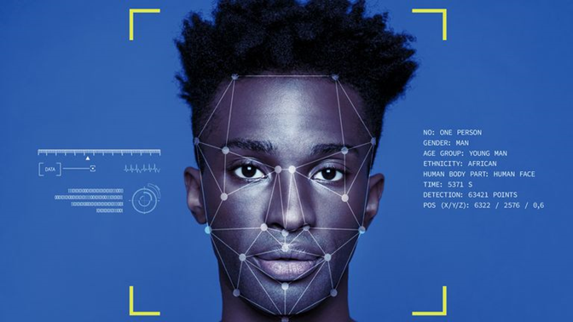
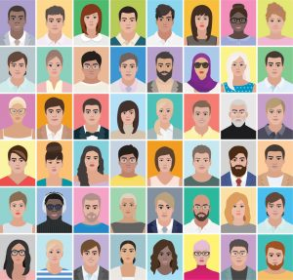
Facial Recognition Systems
The algorithms perform three main tasks:
detect faces from a digital image or video;
calculate a mathematical model of a face;
compare models to databases of images to identify or verify the person
(it should be the same outcome each time)
Each stage can be without the individuals knowledge or consent.

Slide 4
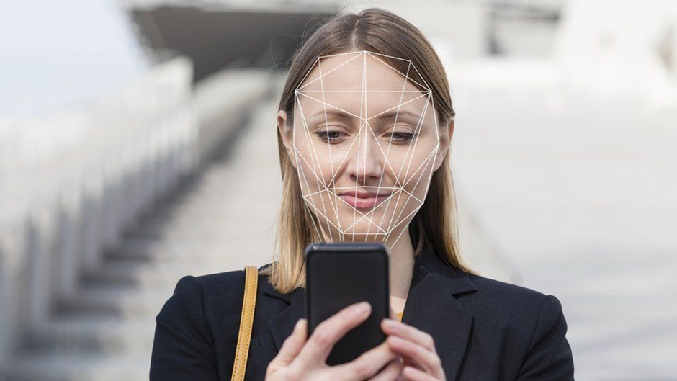
Facial Recognition Uses
Verification
90 - 99.97% accurate
* Unlocking your phone
* Logging into your banking app
* Movement through airport security

Slide 5
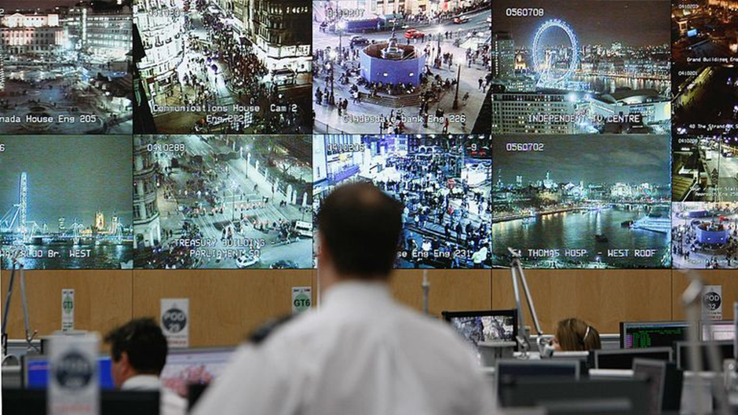
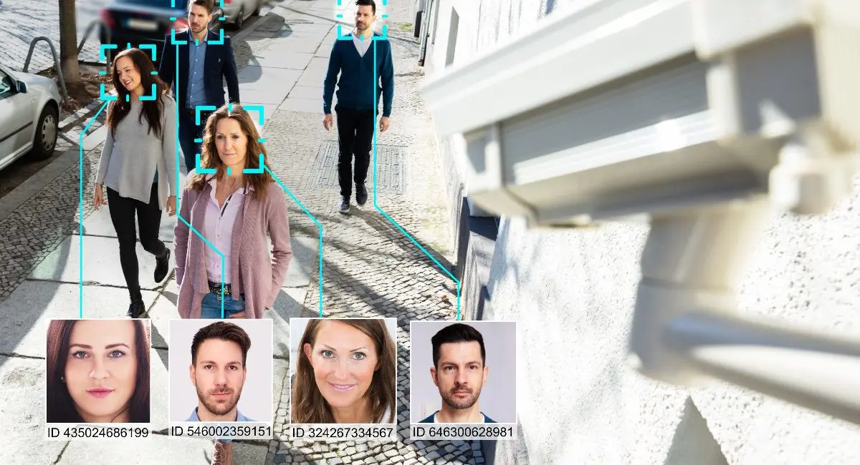
Facial Recognition Uses
Identification
37 - 87% accuracy
* Identifying criminals
At large events
Shoplifters
Human trafficking
* Governments:
Identify voter fraud
Track “people of interest”
* Used in social media - targeting advertisements

Slide 6


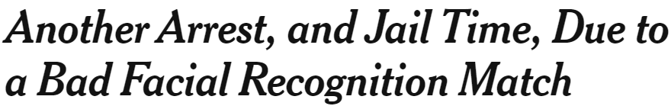
Ethical Challenges
* Unprecedented collection of behaviour and movement data about individuals
* Transparency regarding security and acquisition of database images
* Innocent parties privacy
* Lack of consent
* Identity theft and fraud
* Wrongful arrests from false positives
* Discrimination including against:
Race
Gender
35% of errors occur when identifying black women
1% of errors occur when identifying white men

Slide 7
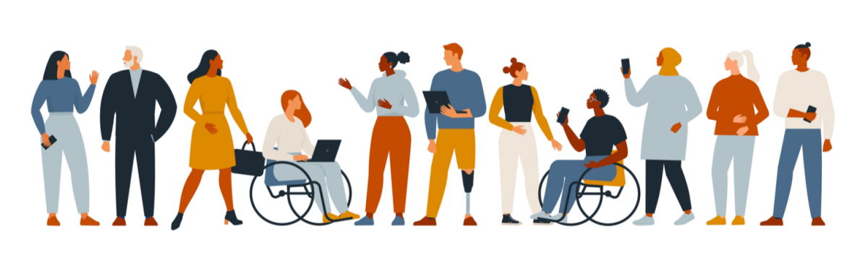
Potential Solutions
Existing systems:
* Enact and monitor stricter legislations
European Parliament voted to ban the use of facial recognition in law enforcement
UK College of Policing say their guidance will be “legal and ethical”
* Transparency over how the systems work internally – enforces stakeholder accountability
* Full customer understanding, consent, and access with the ability to request deletion
Stopping False Positives:
* More diversity in the production teams
* Full training in more robust processes to avoid bias
* Confidence scores
The system only reports back if it is 99% certain of a positive match
Lower if human investigation is involved as a second stage

Slide 8

Regulation is clearly important in order to protect individuals privacy and keep them informed as well as to update user knowledge of all legal process.
Such rapidly evolving and improving systems can undoubtedly speed up daily life and even save lives. However, human input should also be considered in investigations - especially when a false negative could have devastating effects.
“If a system doesn’t work for everyone, it doesn’t work”

Slide 9
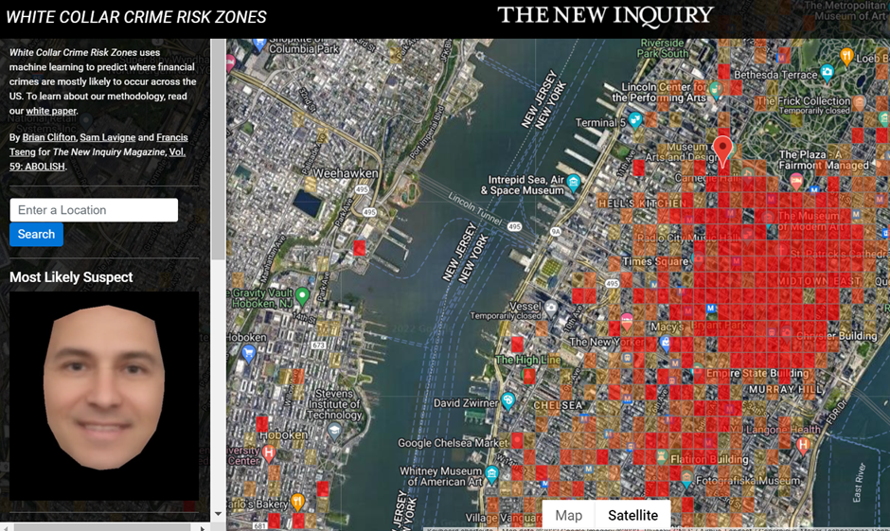
A reminder that we all falsely identified Michael as being guilty of White Collar Crime

Slide 10
References and image credits
https://www.theguardian.com/music/2018/dec/13/taylor-swift-facial-recognition-stalkers-rose-bowl-concert
https://www.nytimes.com/2020/12/29/technology/facial-recognition-misidentify-jail.html
https://www.cepro.com/news/amazon-extends-ban-on-sharing-face-recognition-with-police/
https://www.bbc.co.uk/news/technology-54349538
https://recfaces.com/articles/facial-recognition-algorithms
https://learn.g2.com/ethics-of-facial-recognition
https://www.forbes.com/sites/daveywinder/2019/08/10/apples-iphone-faceid-hacked-in-less-than-120-seconds/?sh=7edec88521bc
https://www.csis.org/blogs/technology-policy-blog/how-accurate-are-facial-recognition-systems-%E2%80%93-and-why-does-it-matter
https://news.sky.com/story/facial-recognition-technology-will-turn-our-streets-into-police-line-ups-campaigners-say-12572433

